Slide 1

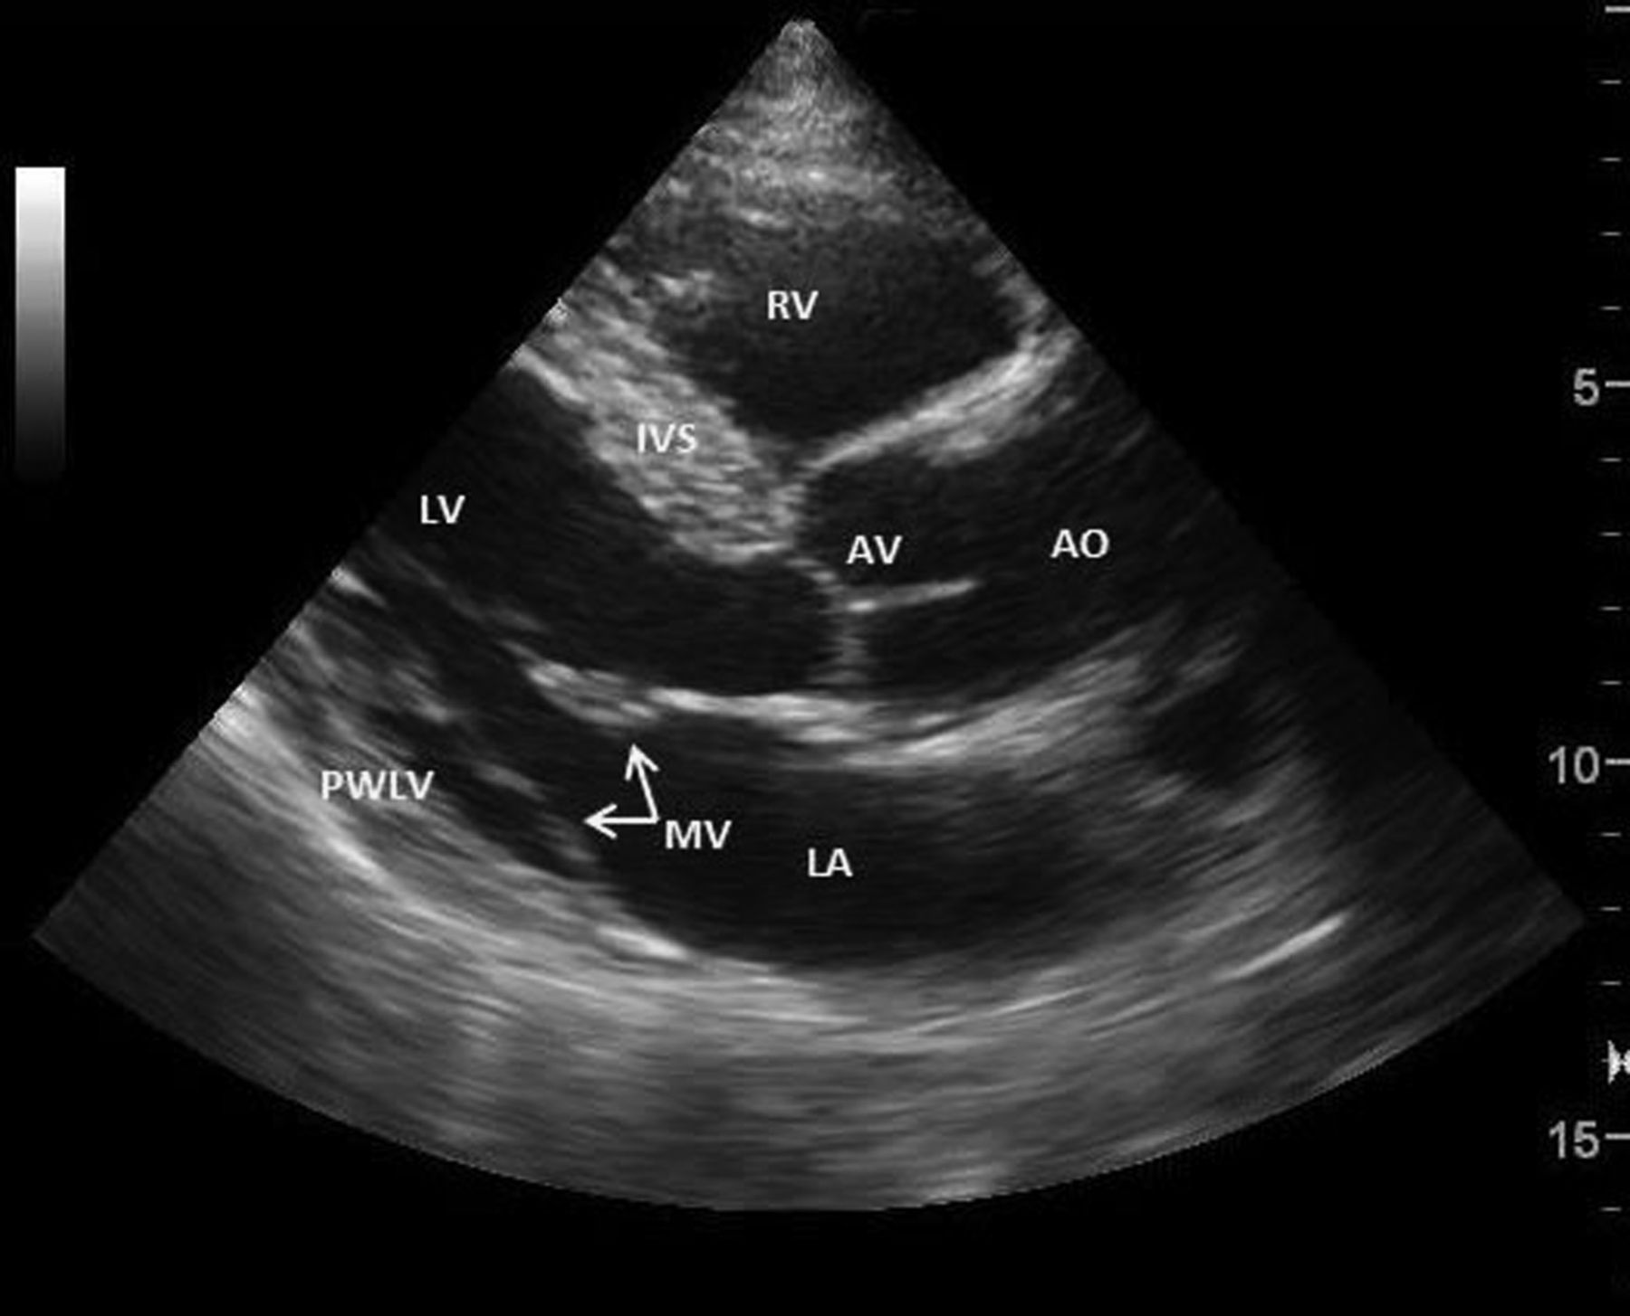

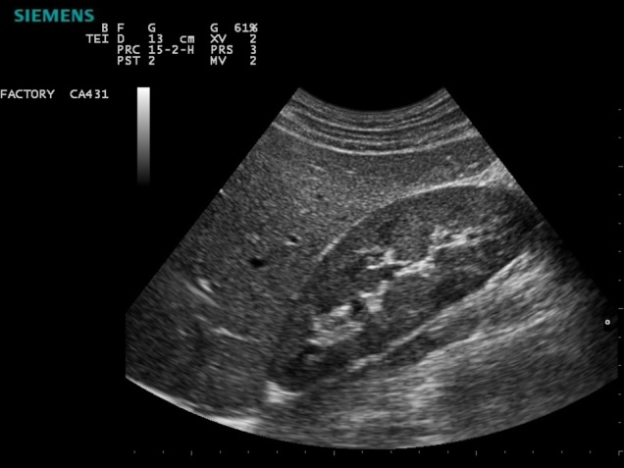
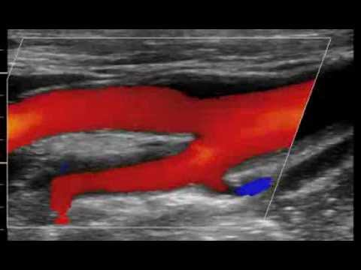
Real-Time Imaging
Chapter 13

Slide 2
Real-Time Imaging: Frame Rate
What makes ultrasound “real-time” is the FRAME RATE of the images put on the monitor
Frame rate is determined by:
1. sound speed within the medium
2. depth you are imaging
In clinical sonography maximum imaging depth determines frame rate
Notes:
Other things effect this like viewing area but will discuss latter

Slide 3

Real-Time Imaging: Frame Rate
Frame rate and time for 1 frame are inversely related and are reciprocals
If you multiply
T frame X frame rate = 1
FR is measured in hertz or “per second”. The units of frame rate are “images per second”.
Notes:
Low fps results in flicker on the monitor

Slide 4
Real-Time Imaging: Frame Rate
Examples:
If an image is created in 1/10 of a sec the frame rate is 10 frames/sec (or 10 Hz)
If an image is created in 1/60 of a sec the frame rate is 60 frames/sec (or 60 Hz)
As the time to needed to make each image decreases, the frame rate increases.

Slide 5
Temporal Resolution (Hz)
Refers to “accuracy in time” –the ability to precisely position moving structures from instant to instant.
Determined by:
Frame rate
best with high number of frames per sec. (high frame rate)
worse when few frames are displayed per sec. (low frame rate)
Notes:
reciprocals

Slide 6
Settings That Determine Frame Rate
Sonographer-controlled settings of the system determine frame rate:
1. imaging depth
2. number of pulses in each picture

Slide 7
Imaging Depth
Depth and frame rate are inversely related
T = # of pulses X PRP frame
Less time for each frame,
higher frame rate.
More time for each frame,
lower frame rate.
Notes:
PRP pulse repetition period or round trip time of the pulse

Slide 8
Example # 1
An u/s system creates each image with 100 separate pulses. The max. depth that requires a round-trip time (also called PRP) of 1/1,000 second.
T frame = # of pulses X PRP frame
= 100 pulses X 1/1000 sec.
= 1/10 sec. and the frame rate is 10 HZ

Slide 9
Example # 2
The sonographer adjusts the DOV to ½ as deep. The time of flight is 0.5/1000sec. (½ as deep means the go-return time is ½ as long)
The image still requires 100 pulses.
T = # of pulses X PRP frame
= 100 pulses X 0.0005 sec.
= 0.05 sec. or 1/20 sec
Frame rate increases to 20 Hz and temporal resolution is better.

Slide 10
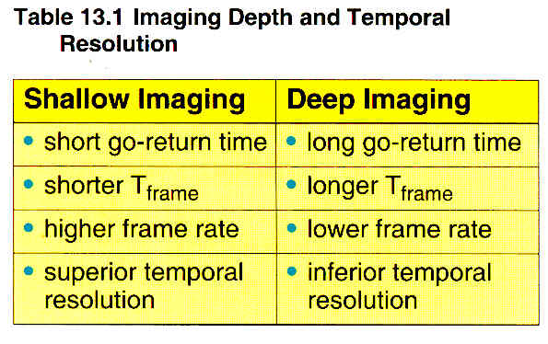

Slide 11
Pulses Per Image
Higher frame rates are possible if each individual image is created with less pulses.
Low frame rates occur when each image is made with more pulses.
So, pulses per image and frame rate are inversely related

Slide 12
Pulses per Image
Three factors that determine # of pulses needed to create the image:
1. number of pulses per scan line
(multi- vs. single focus)
2. sector size
3. lines per angle of sector (line density)

Slide 13
Pulses Per Image
Number of pulses per scan line
When another focal zone is added, the number of pulses sent at each scan line increases.
This increases the time required to create each line.
Single focus
requires 1 sound
pulse for each
scan line
Multi-focus

Slide 14
Example
An u/s machine requires 200 scan lines to create an image:
A single focus transducer sends 200 pulses,
With 3 foci 600 pulses are required
Frame rate and temporal resolution diminish with multi-focus.

Slide 15
Multi-focus
Why use multi focal zones since it decreases temporal resolution?
With multiple focal images each scan line has superior lateral resolution because it is narrow over a wide range of depths – a trade-off to pay

Slide 16
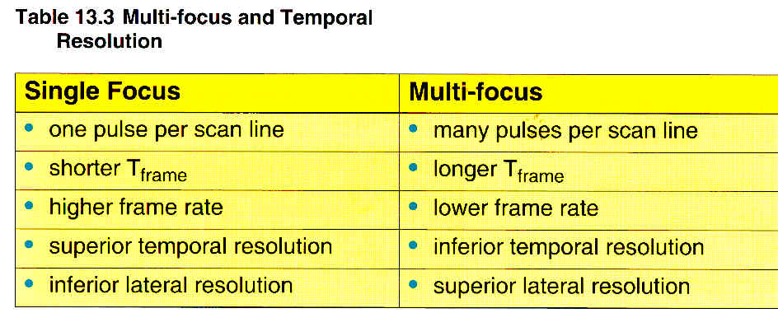

Slide 17
Sector Size aka Field of View
Increasing the size of the sector:
a. the # of pulses to make the image increases
b. longer T frame
c. lower frame rate
d. temporal resolution decreases
Field of view and frame rate are inversely related.
Narrower images have higher frame rates
Wider images have lower frame rates

Slide 18
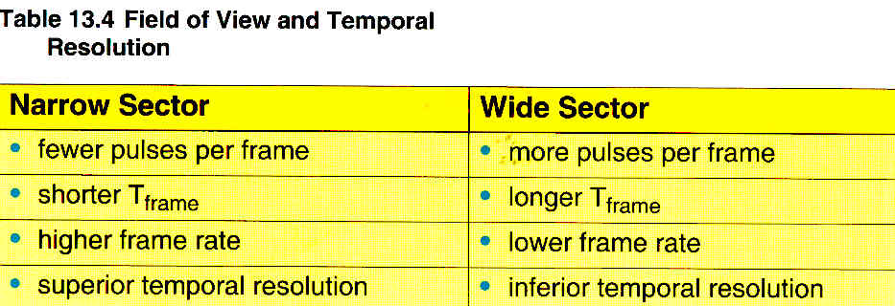

Slide 19
Line Density
Low line density
This is the amount of spacing between sound beams
The # of scan lines in the sound beam
Sonographers may have control over the spacing between the scan lines or some systems have it automatically set
spacing lines further apart results
in a low line density
High line density

Slide 20
Line Density
High line densities decrease FPS resulting in a negative impact on temporal resolution.
So why use high line densities?
High line densities improves spatial resolution (better detail)
The sonographer must balance the two

Slide 21
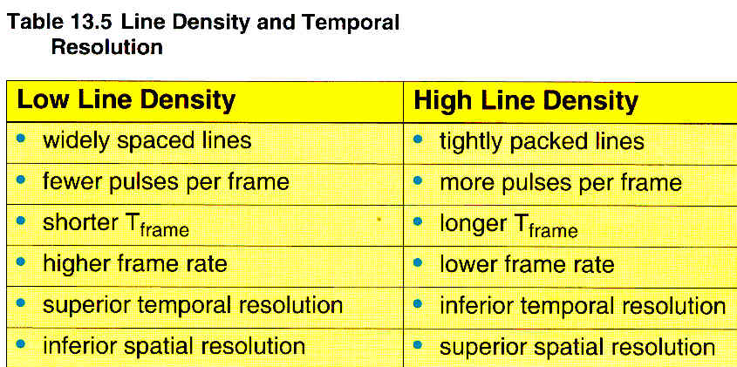
Factors Affecting # of Pulses Required to Create an Image

Slide 22
Resolution Advantages
Lateral resolution ^ with multi-focusing
Spatial resolution ^ with higher line density

Slide 23
Flicker Fusion Rate
Image Formation
a. Lines of sight: each image is composed of many individual lines of sight
b. Pixels: each line of sight is composed of many picture elements (pixels)
c. Motion: many single images are displayed on the screen in one second to produce the illusion of motion
d. Frame rate: number of frames displayed on the screen per second = frames per second = fps
e. Flicker Fusions Rate: minimum number of images that must be displayed to produce “motion”. For the human eye it is approximately 25 fps

Slide 24
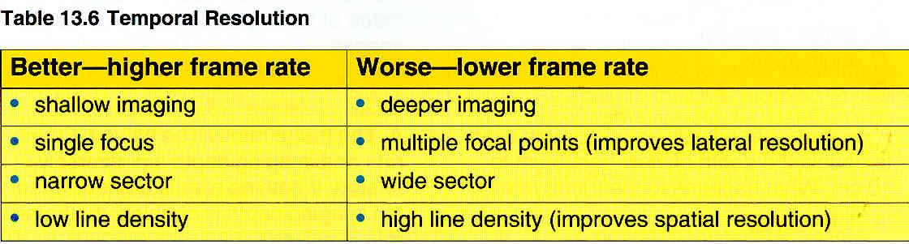
Summary of Temporal Resolution

